Slide 1

Machine Learning Project CREDIT CARD FRAUD DETECTION
Vinoth Kumar Jayandiran

Slide 2
OVERVIEW
Project Description
Data Exploration and Preprocessing
Training the Models
Results

Slide 3
Project Description
Purpose: The purpose of this project is to develop an effective credit card fraud detection system using machine learning techniques.
Importance: Credit card fraud is a significant concern for financial institutions and cardholders, leading to financial losses and compromised security. Our project aims to mitigate these risks by implementing advanced algorithms for fraud detection.
Objective: Our objective is to create a robust and accurate fraud detection model that can classify transactions as either fraudulent or legitimate in real-time, enabling timely preventive actions.

Slide 4
Data Exploration and Preprocessing
The dataset comprises credit card transactions made by European cardholders in September 2013. It covers a span of two days, with a total of 284,807 transactions. Within this dataset, there are 492 instances of fraudulent transactions, indicating a highly imbalanced class distribution. Specifically, the positive class (frauds) accounts for only 0.172% of all transactions.
The response variable is denoted by the feature 'Class,' which takes a value of 1 in cases of fraud and 0 otherwise.
There are 31 variables in the dataset
There are no missing values
The dataset was obtained from Kaggle.com and the dataset link is below CreditCardFraudDataset

Slide 5
Data Exploration and Preprocessing
The variables are:
Variables that are less correlated were removed and below variables are considered for further preprocessing (V3, V4, V7, V10, V12, V14, V16, V17, Class)
Features V1, V2, … V28 are the principal components obtained with PCA, the only features which have not been transformed with PCA are 'Time' and 'Amount’.
Time
V1 to V28 (Total 28)
Amount
Class

Slide 6
Data Exploration and Preprocessing
Undersampling and oversampling are techniques used to address class imbalance
Finally, the undersampled majority class (Class 0) and the oversampled minority class (Class 1) are combined using the rbind function to create a new dataset that has an equal number of instances from both classes.
100,000 total observations with 9 features

Slide 7
Data Exploration and Preprocessing
Table and Bar Plot is used to view the class distribution of Class feature.
Histogram is used to view the class distribution of Time and Amount feature.
To find the correlation of every feature vs Class cor function and plotting is used.
Box plots and Density plots were used to evaluate the relationship between the Class variable and the other feature variables
For every variable, t-tests indicated a relationship with the class variable
The visualizations and test results are shown on the following slides

Slide 8
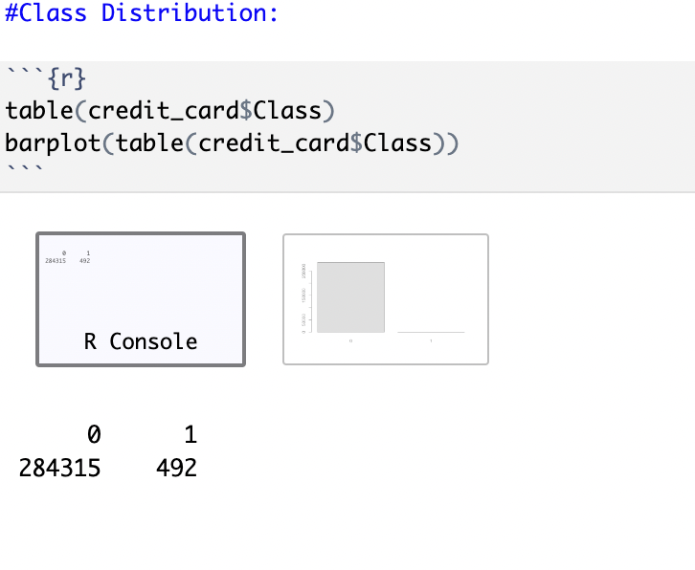
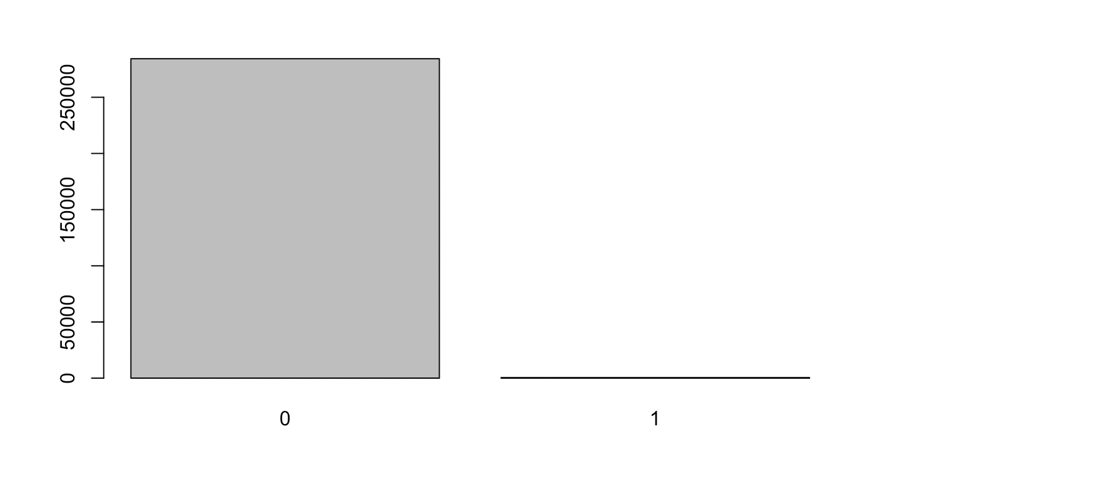
Data Exploration and Preprocessing Class Distribution

Slide 9
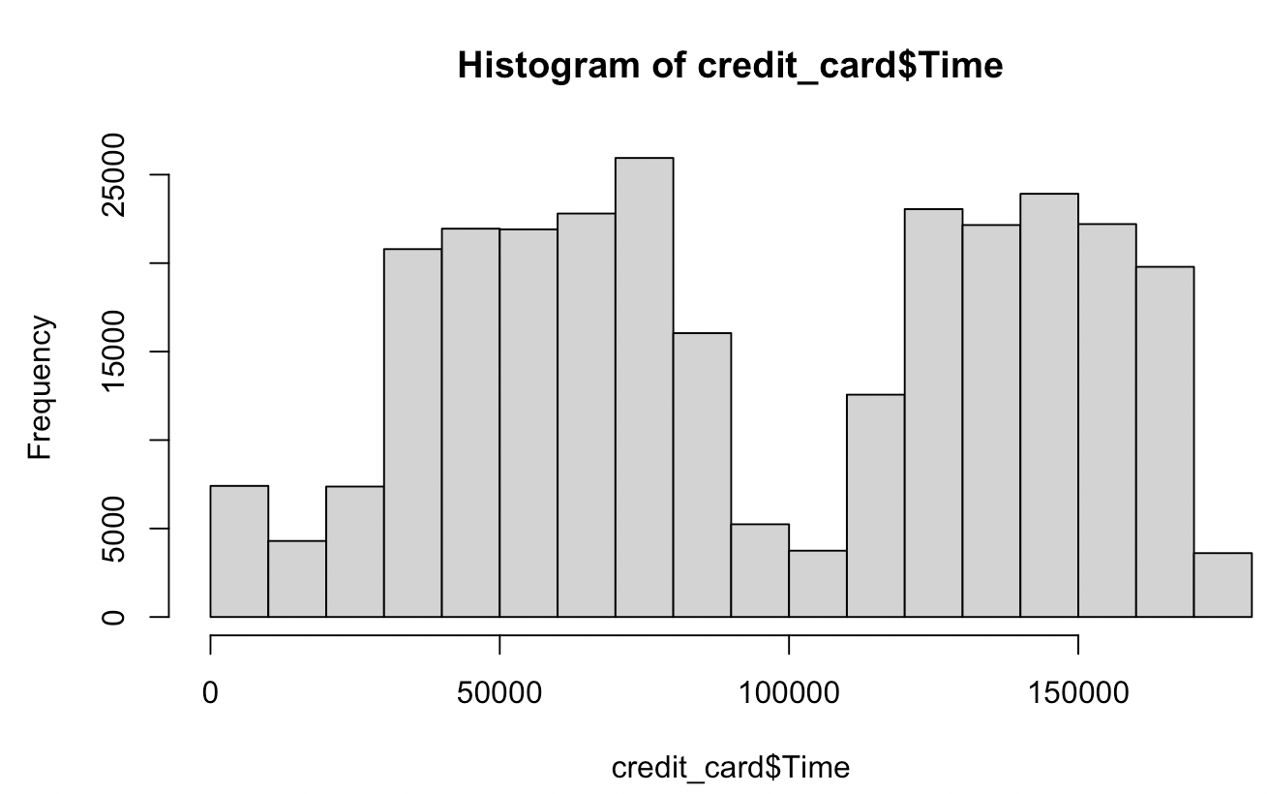
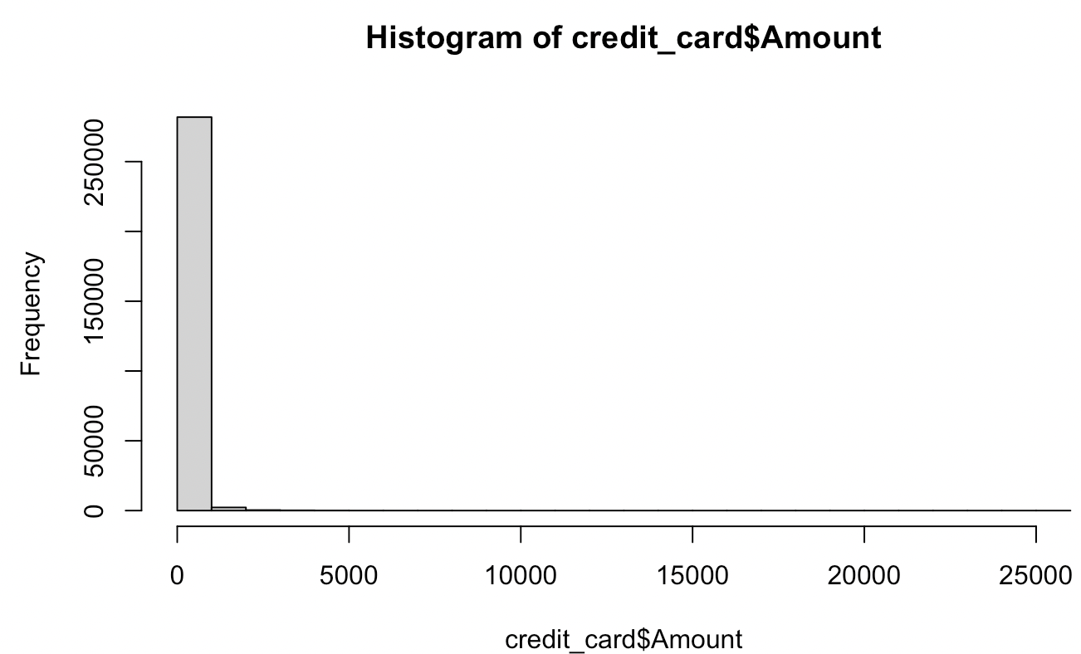
Data Exploration and Preprocessing Histogram of Time and Amount

Slide 10
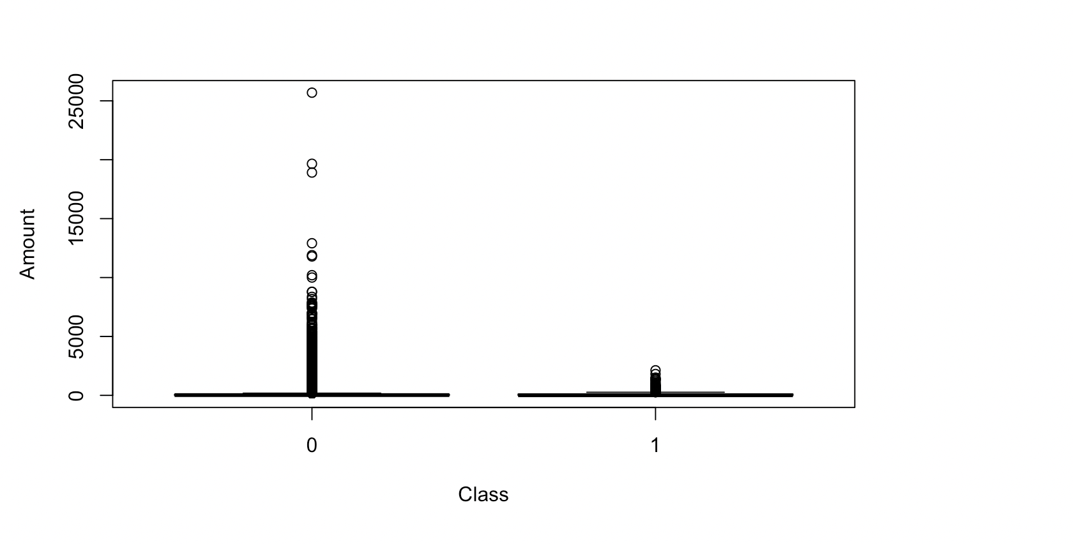
Data Exploration and Preprocessing Box plot of Class by Amount

Slide 11
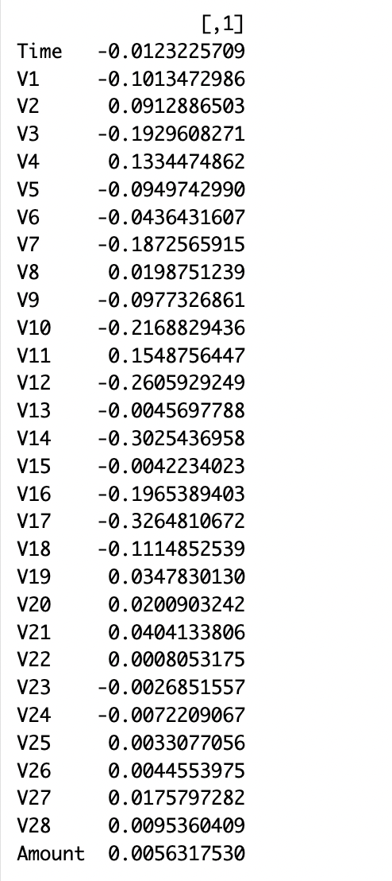
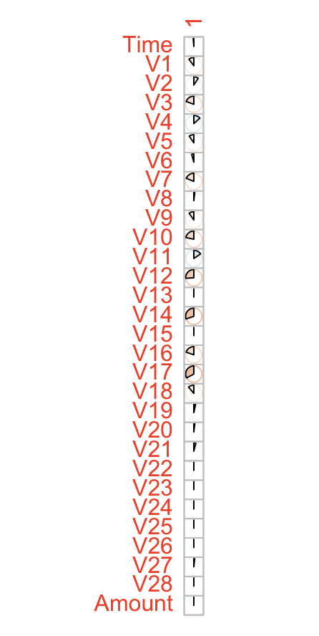
Data Exploration and Preprocessing Correlation between All Feature vs Class

Slide 12
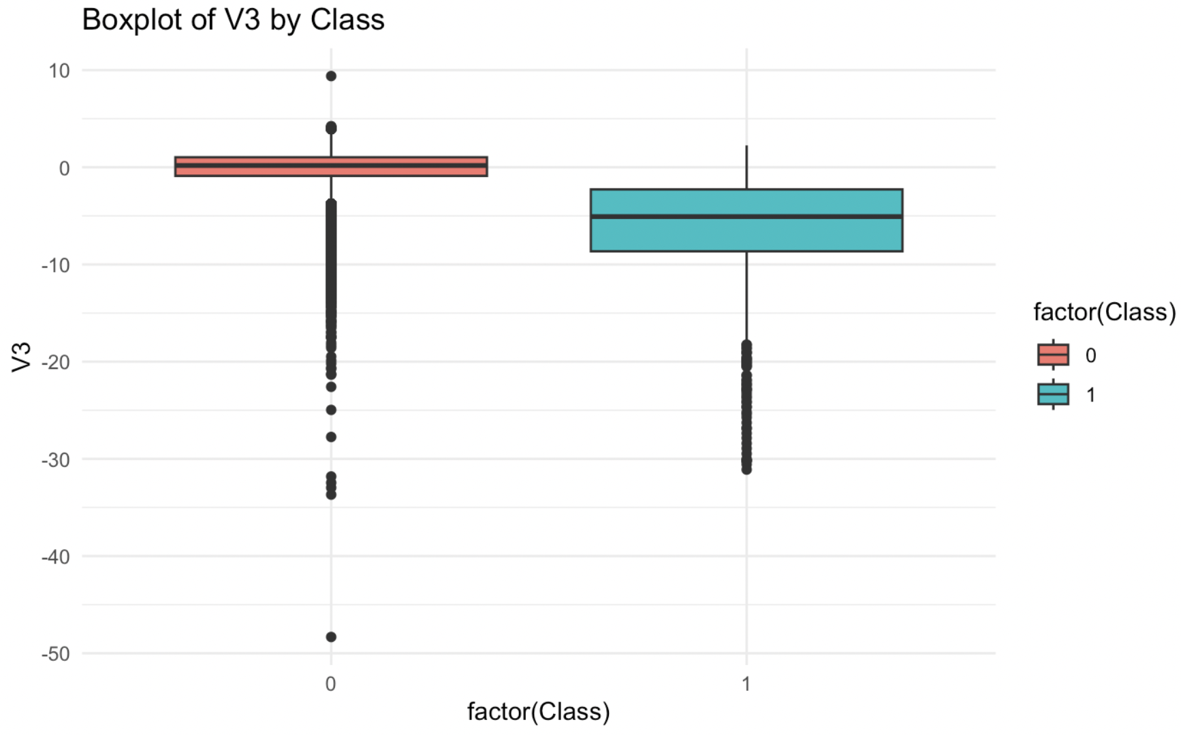
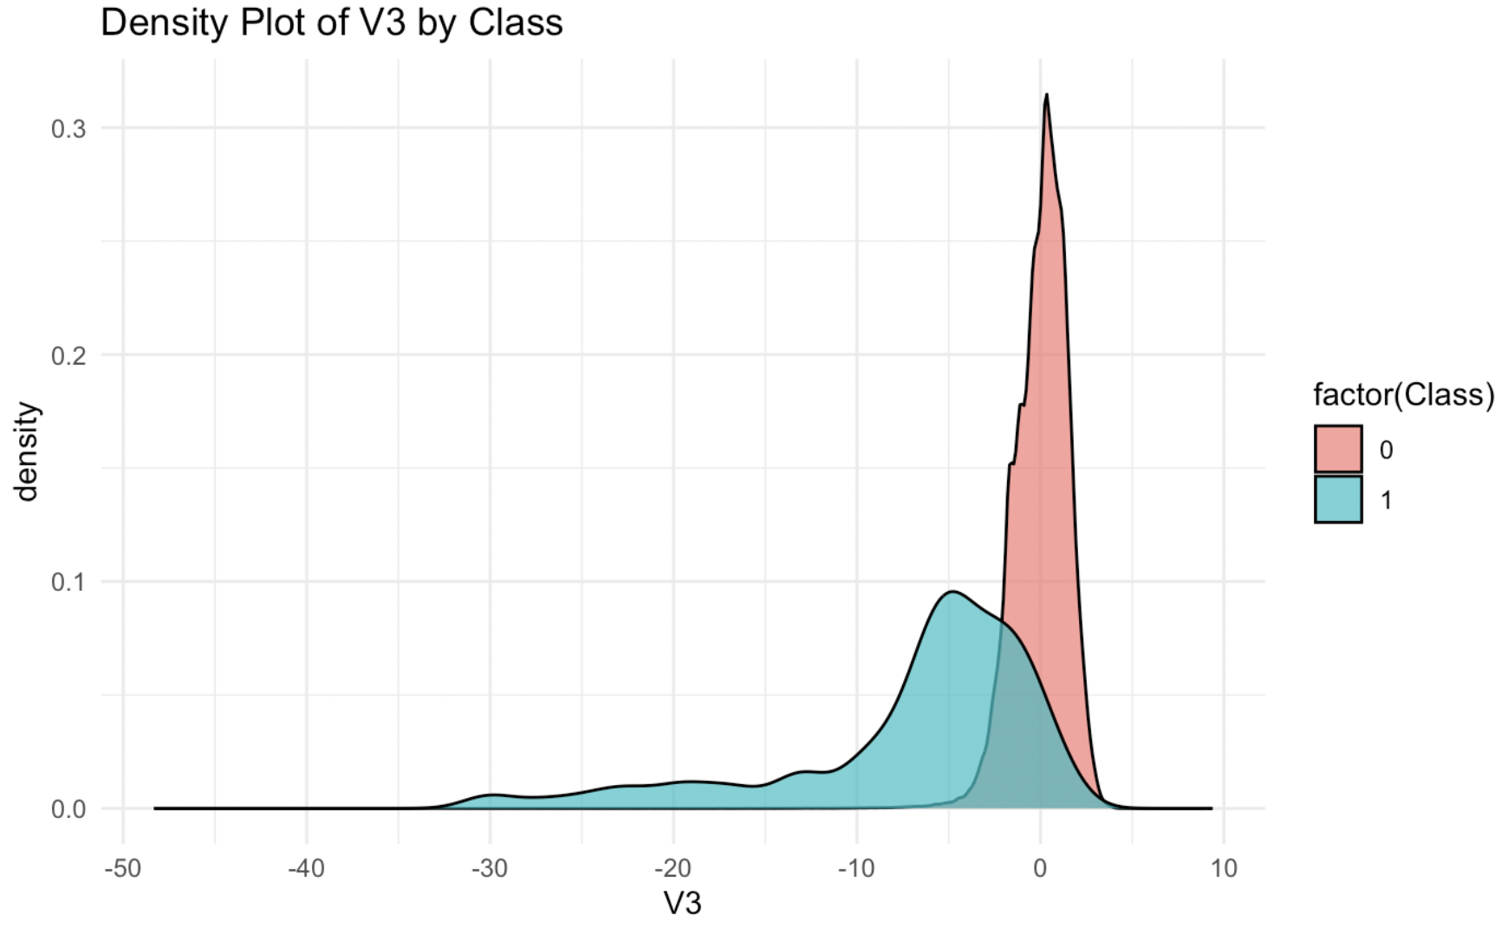
Data Exploration and Preprocessing Box and Density Plot V3 by Class

Slide 13
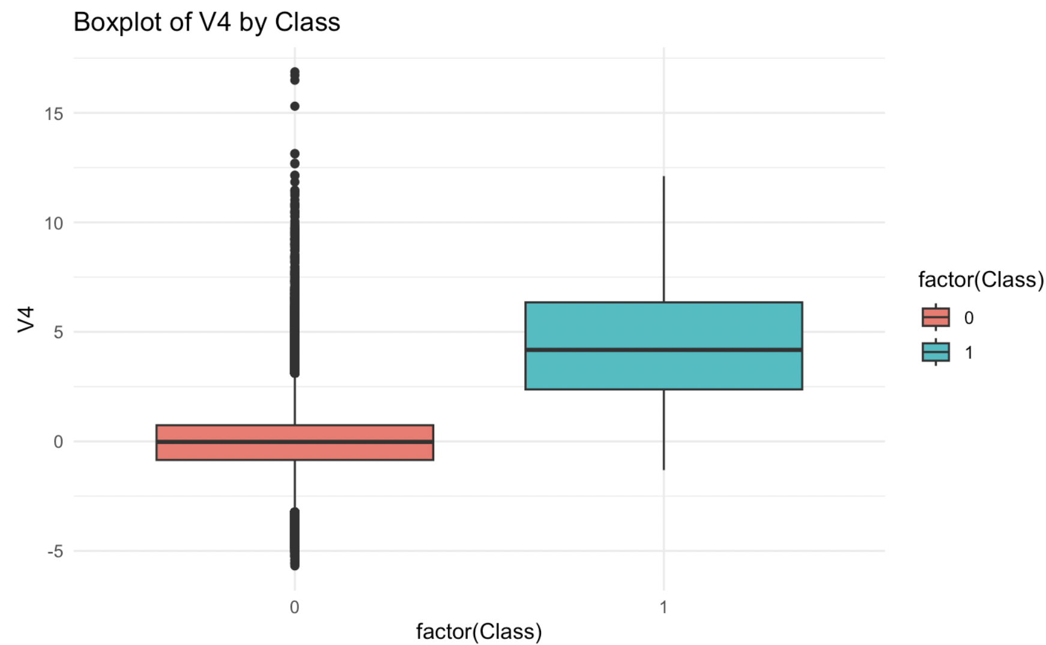
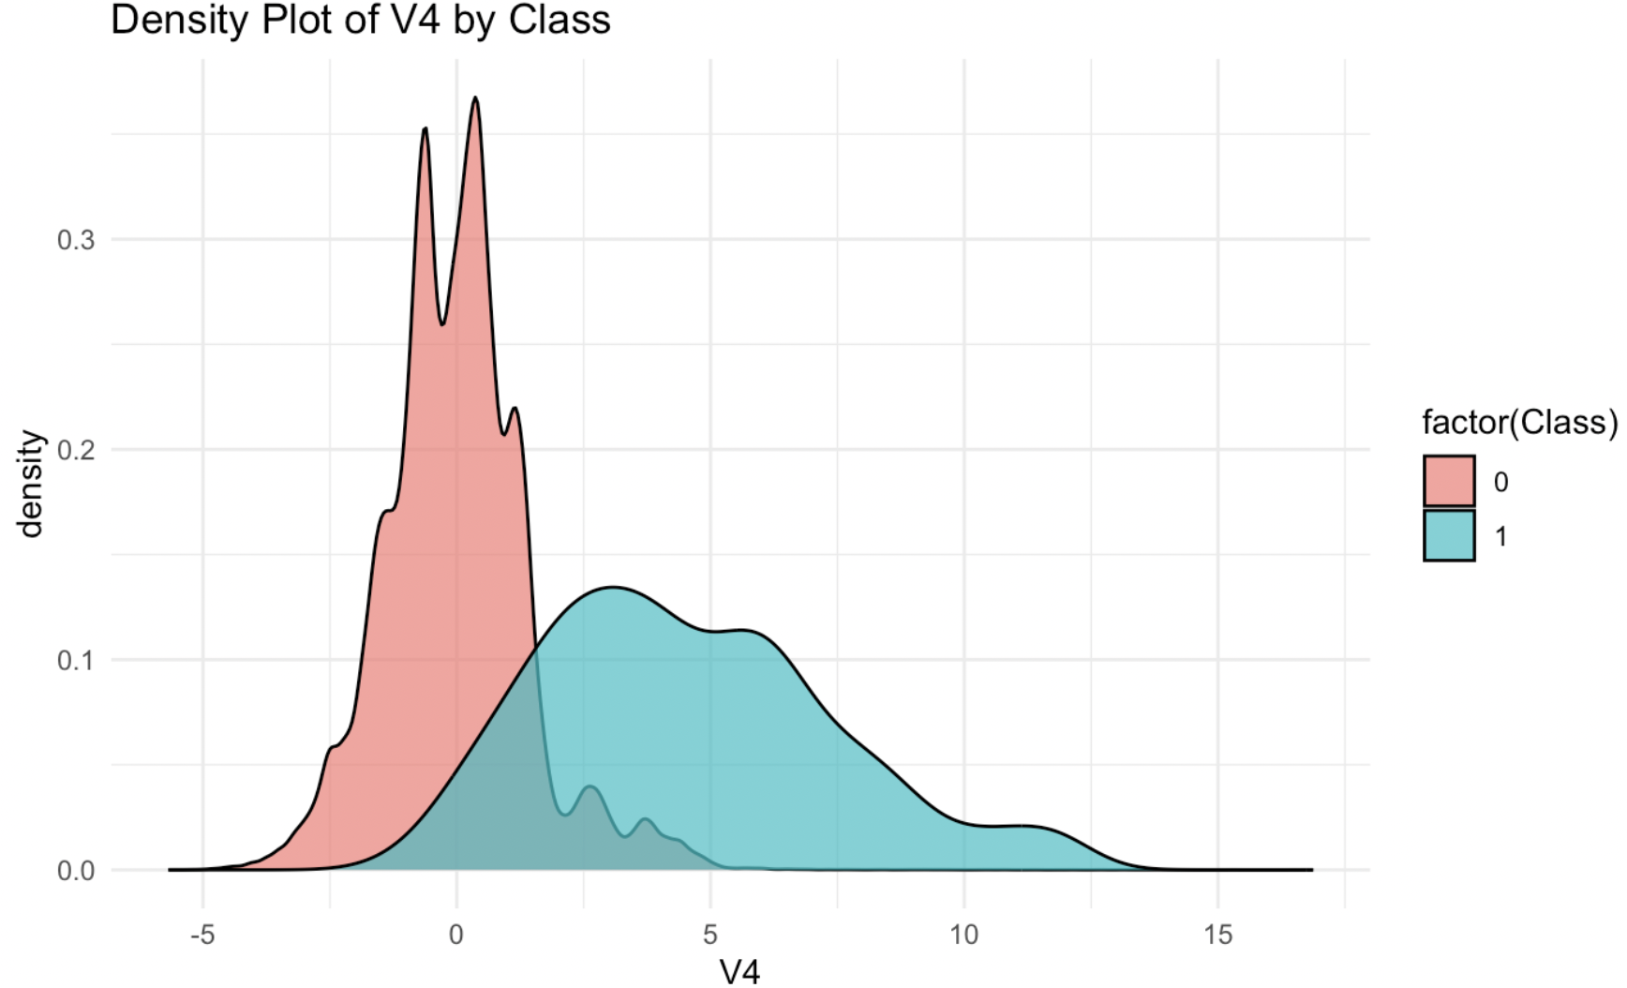
Data Exploration and Preprocessing Box and Density Plot V4 by Class

Slide 14
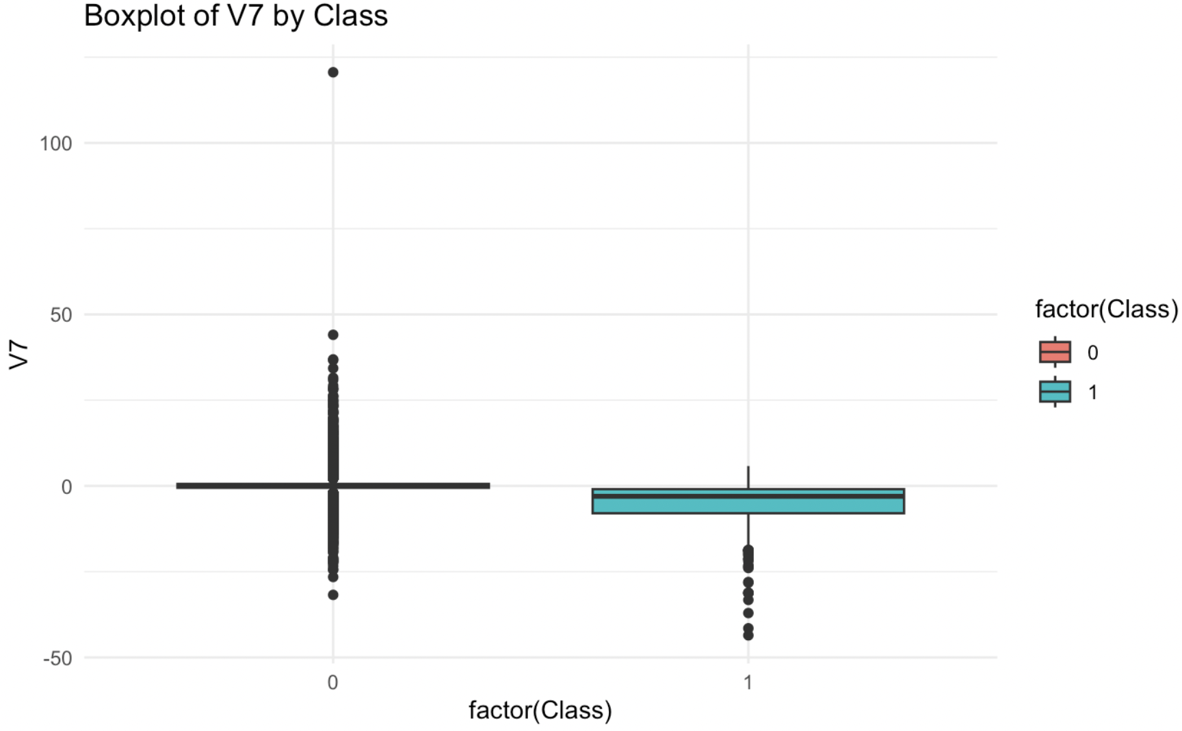
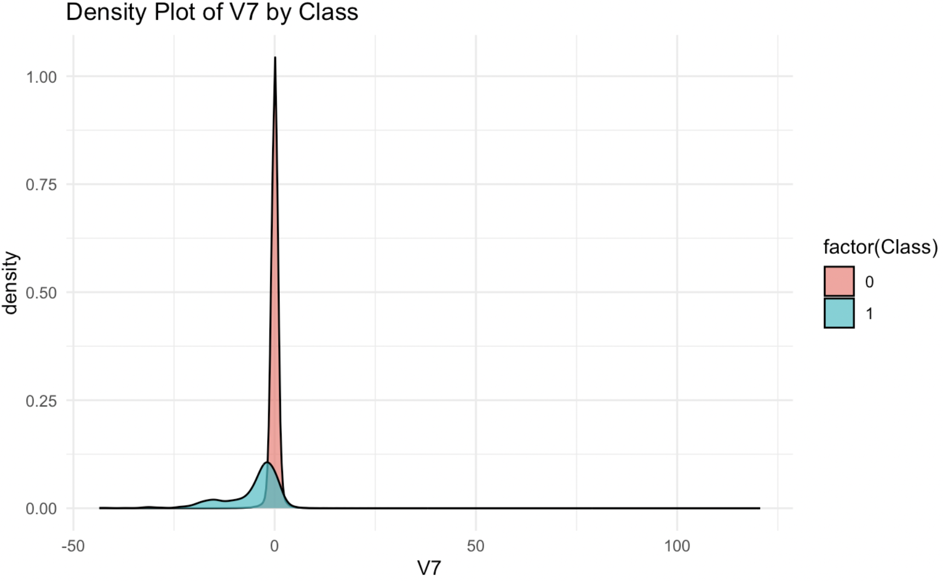
Data Exploration and Preprocessing Box and Density Plot V7 by Class

Slide 15
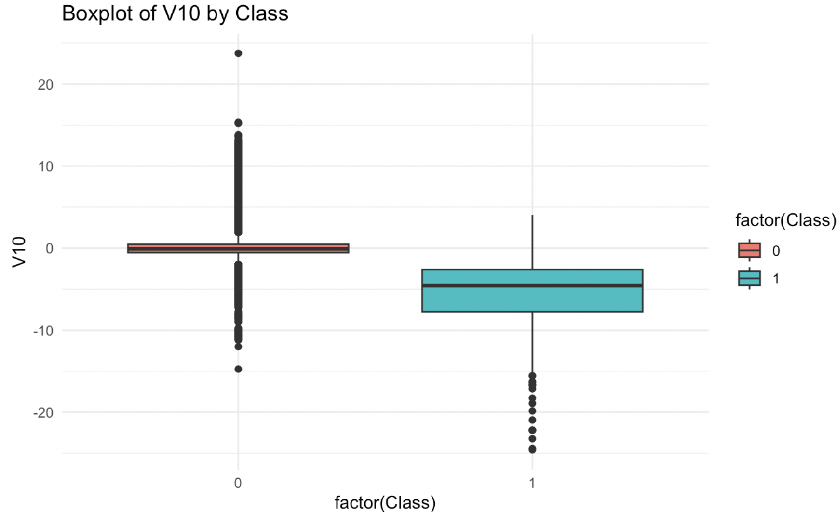
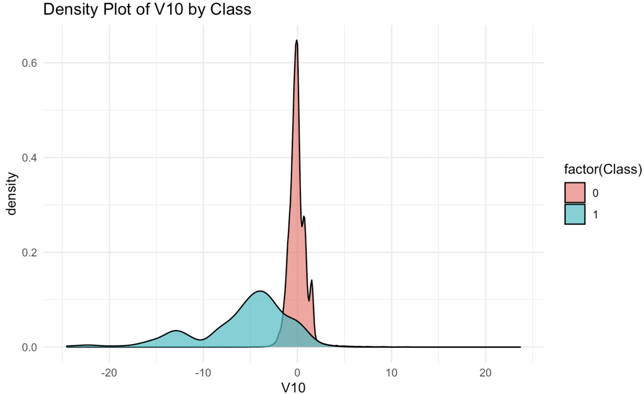
Data Exploration and Preprocessing Box and Density Plot V10 by Class

Slide 16
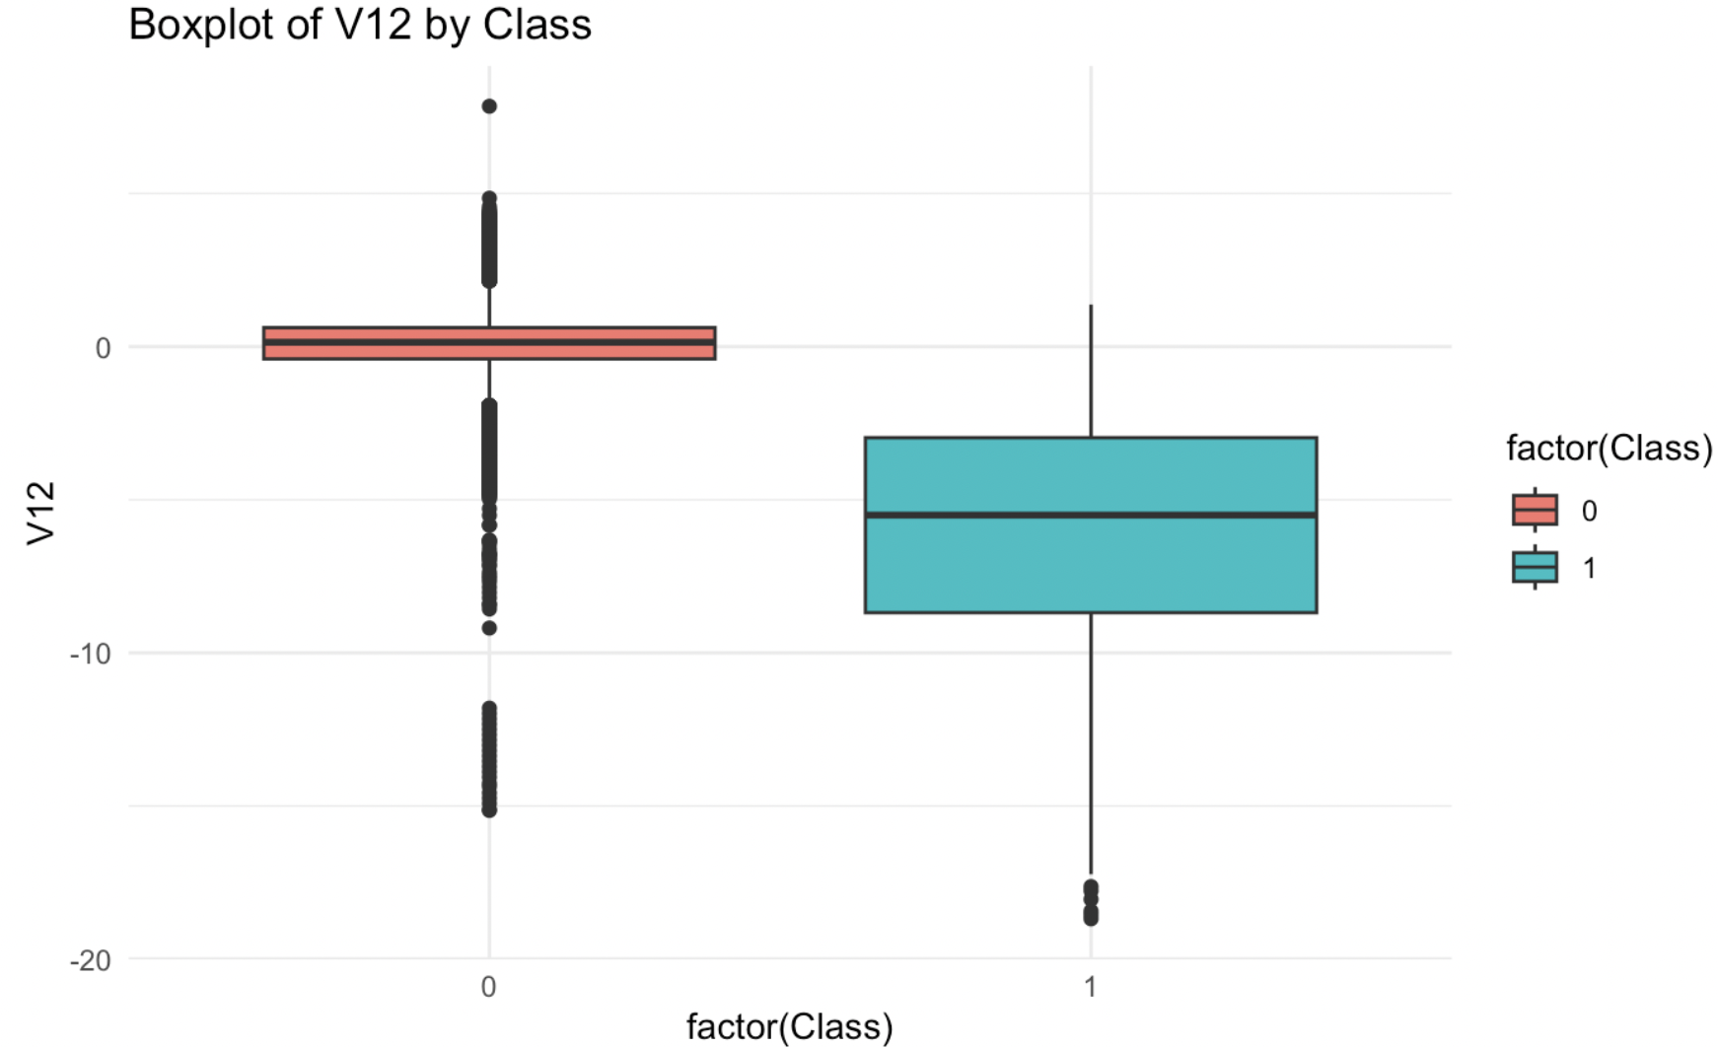
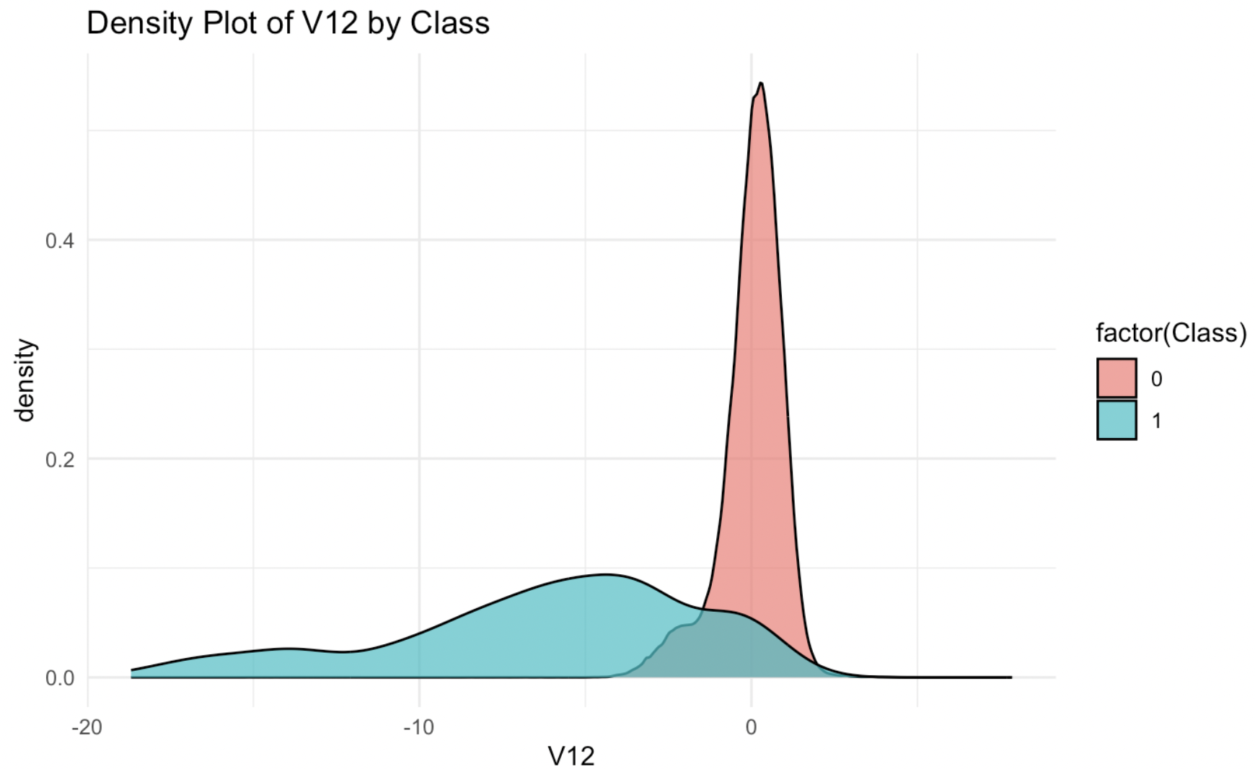
Data Exploration and Preprocessing Box and Density Plot V12 by Class

Slide 17
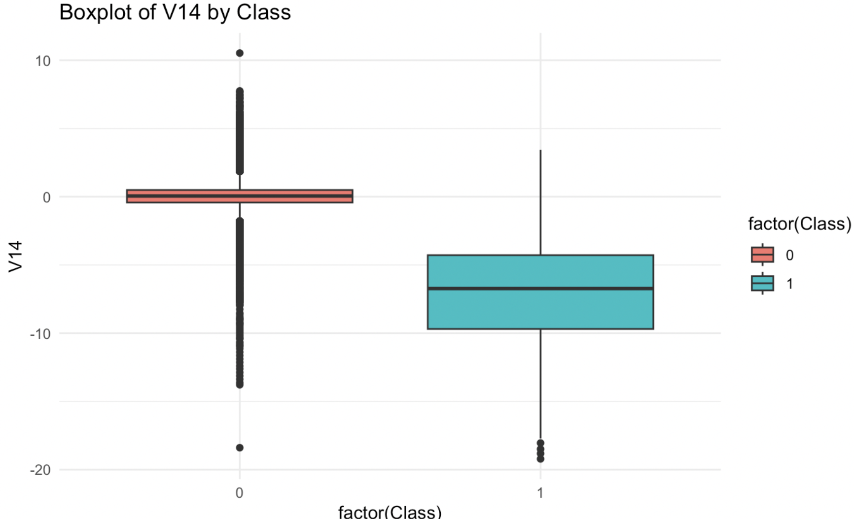
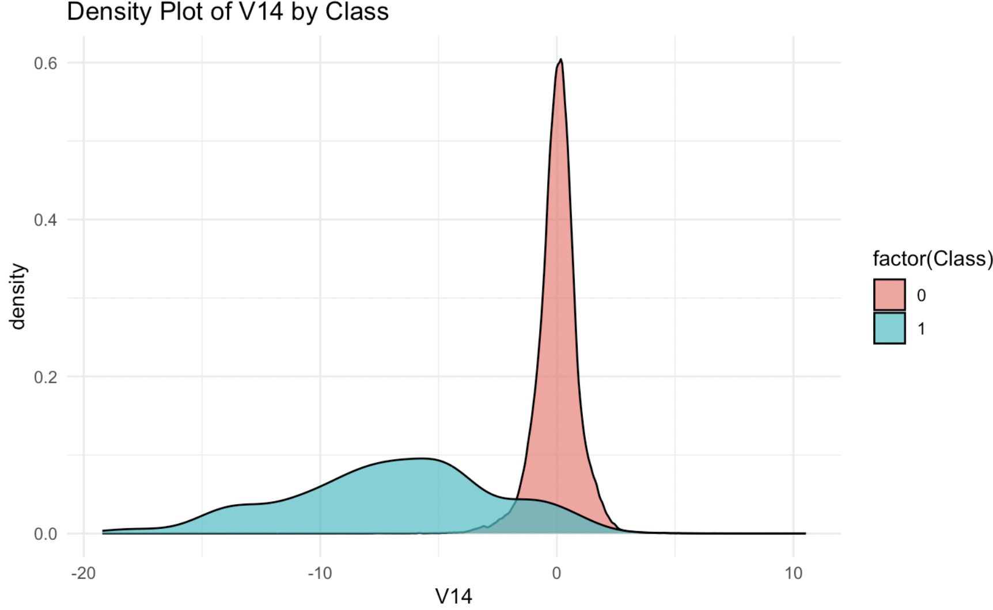
Data Exploration and Preprocessing Box and Density Plot V14 by Class

Slide 18
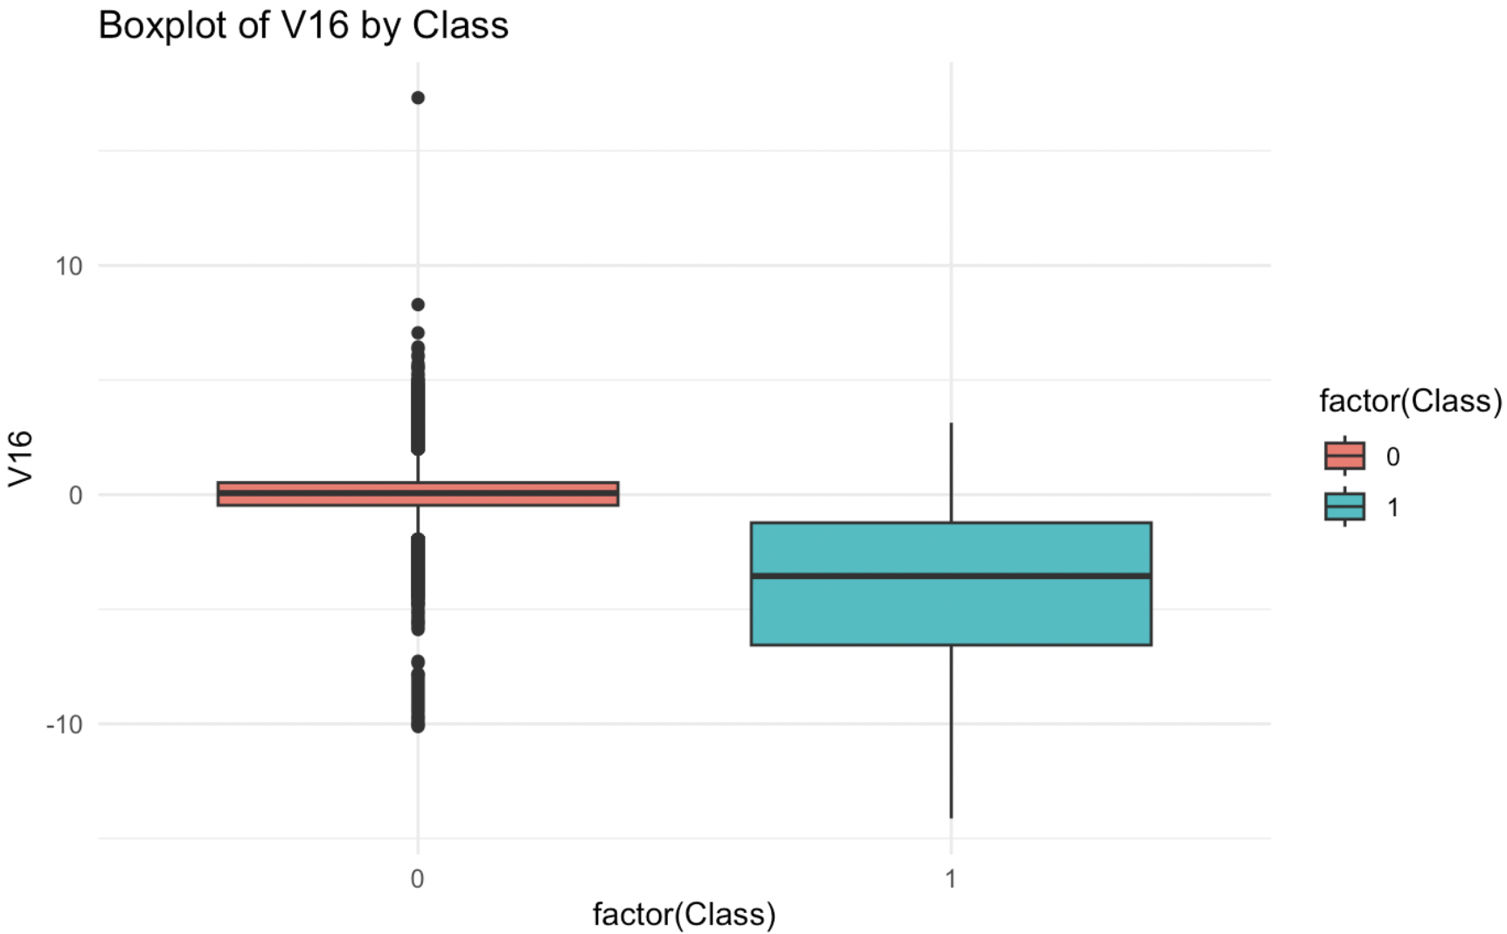
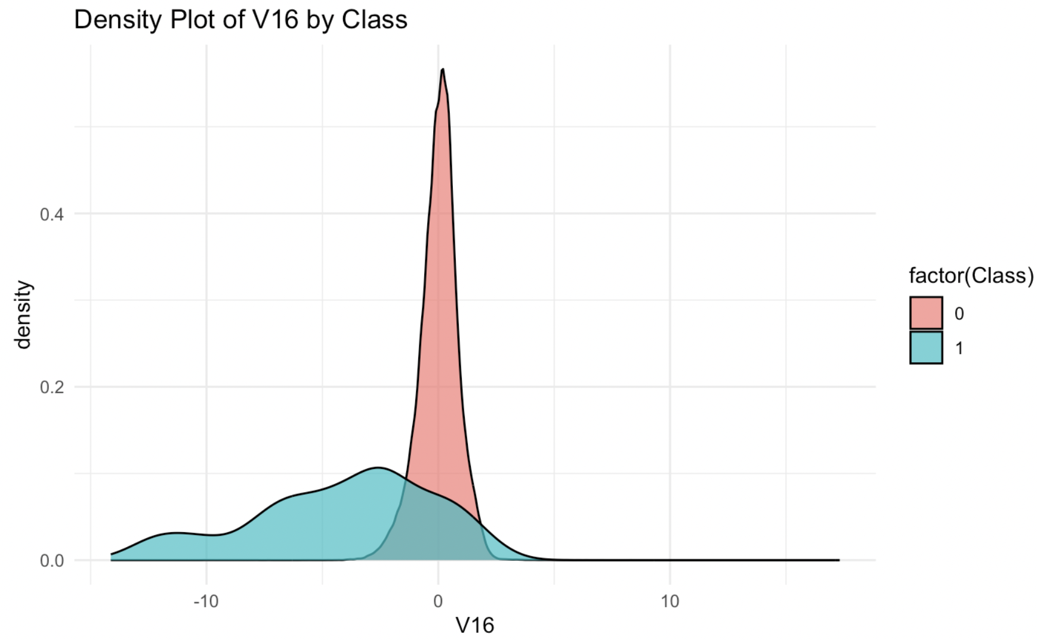
Data Exploration and Preprocessing Box and Density Plot V16 by Class

Slide 19
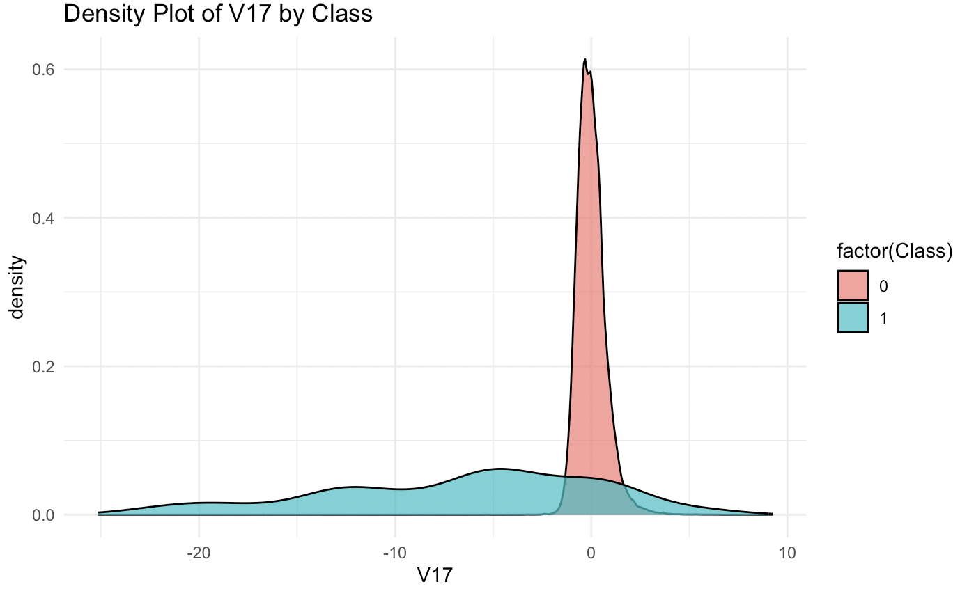
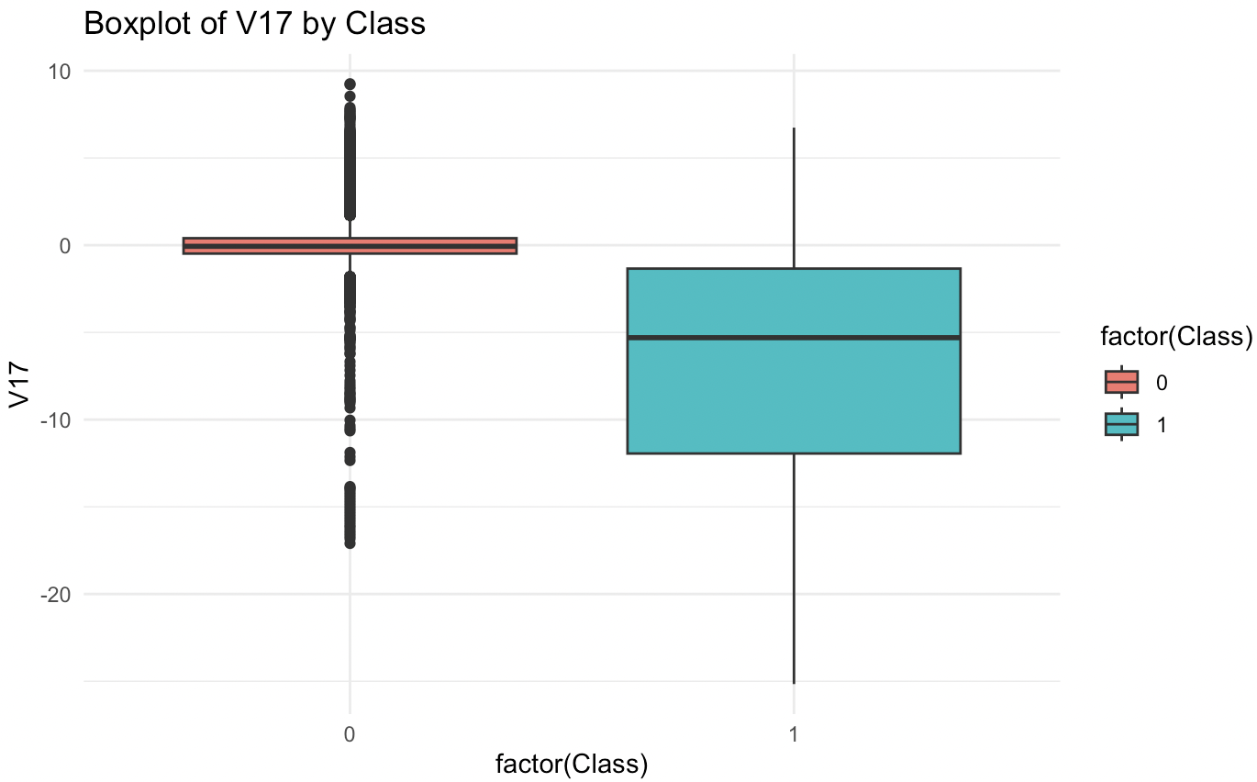
Data Exploration and Preprocessing Box and Density Plot V17 by Class

Slide 20
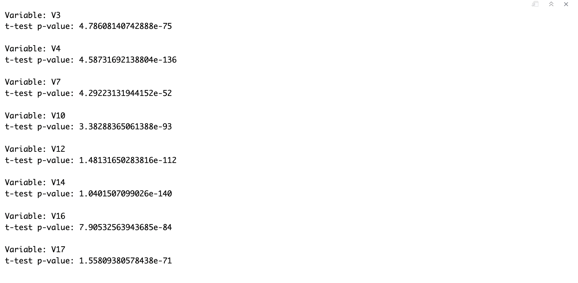
Data Exploration and Preprocessing t-test between variables by Class

Slide 21
Data Exploration and Preprocessing
The dataset was randomized before splitting the data into testing(30%) and training(70%) sets.
The train and test sets were duplicated, converted to all numeric, and normalized using min-max normalization so all variable values were between 0 and 1
•The dataset was used to train Random Forest, Decision Tree Model using C50, Decision Tree Model using rpart, XGBoost, KNN, KNN Smote, Gradient Boosted Tree model, SVM Radical, Neural Network, Neural Network with Class weight, SVM, SVM Smote

Slide 22
Training the Models
10-fold cross-validation and the caret package were used to train and tune the models (except the neural network)
6 classifiers were trained and tuned:
Random Forest
Decision Tree Model(c50)
Decision Tree Model(rpart)
XGBoost
KNN
KNN Smote
GB Tree model
SVM Radical
Neural Network
Neural Network with Class weight
SVM
SVM Smote

Slide 23
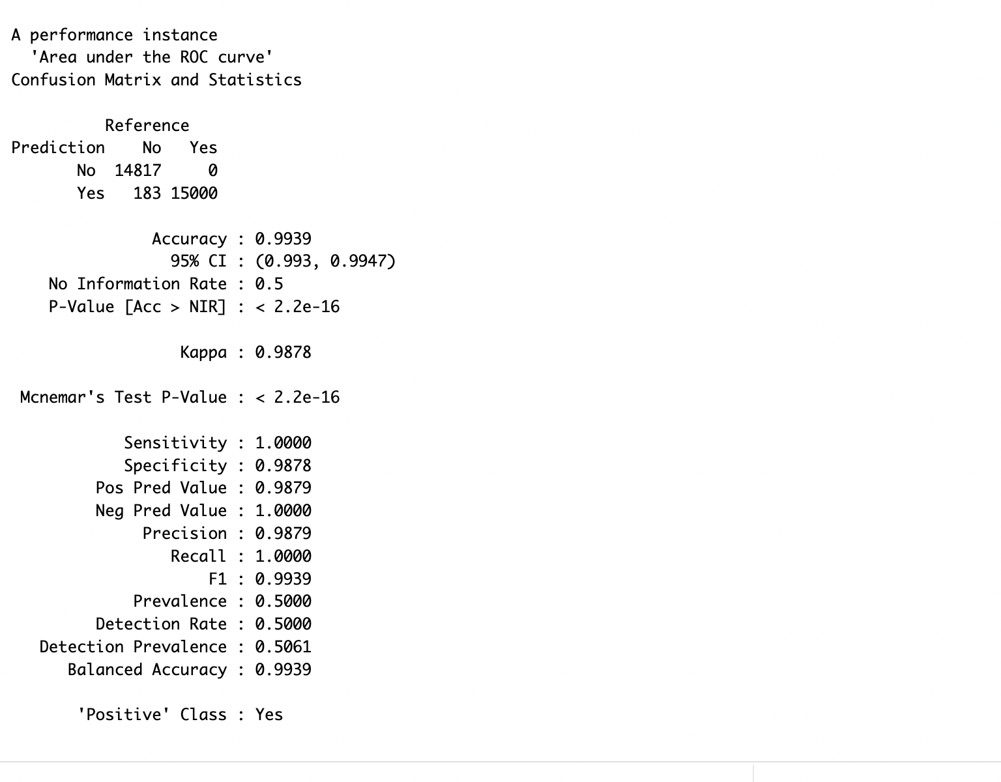
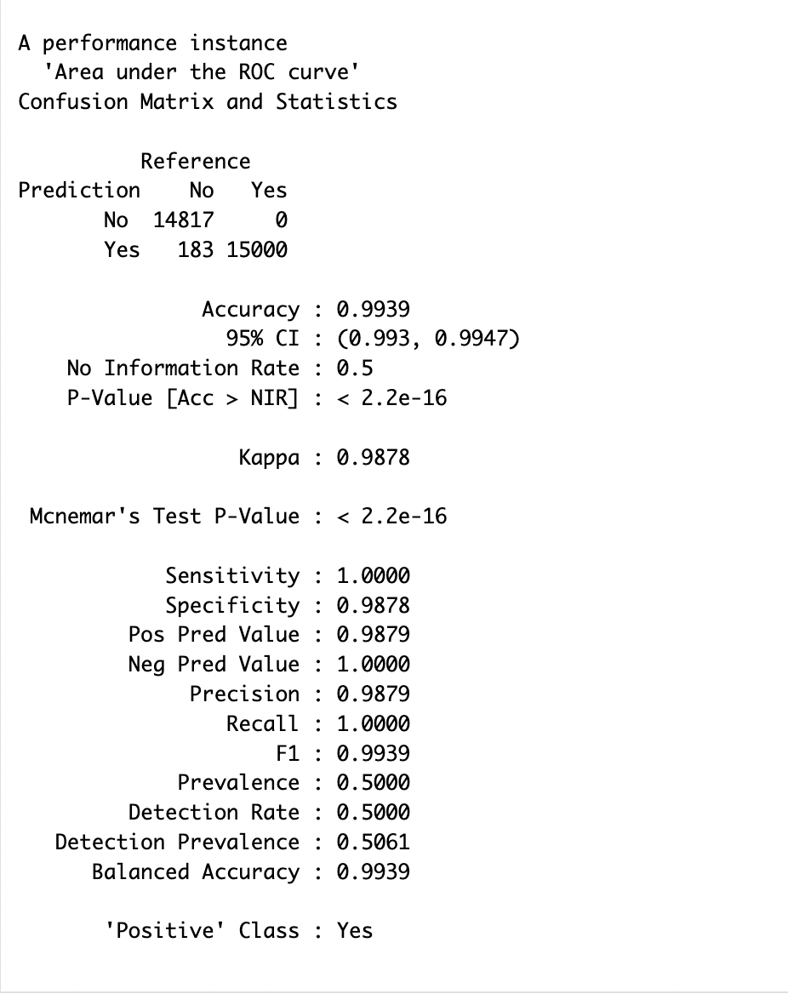
Training the Models Knn and Knn Smote
Both Knn and Knn Smote Models returned accuracy of 99.39

Slide 24
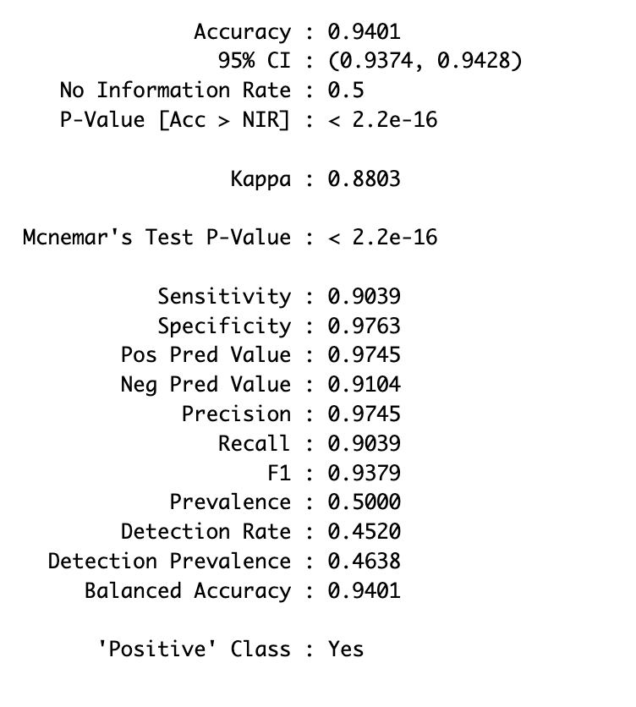
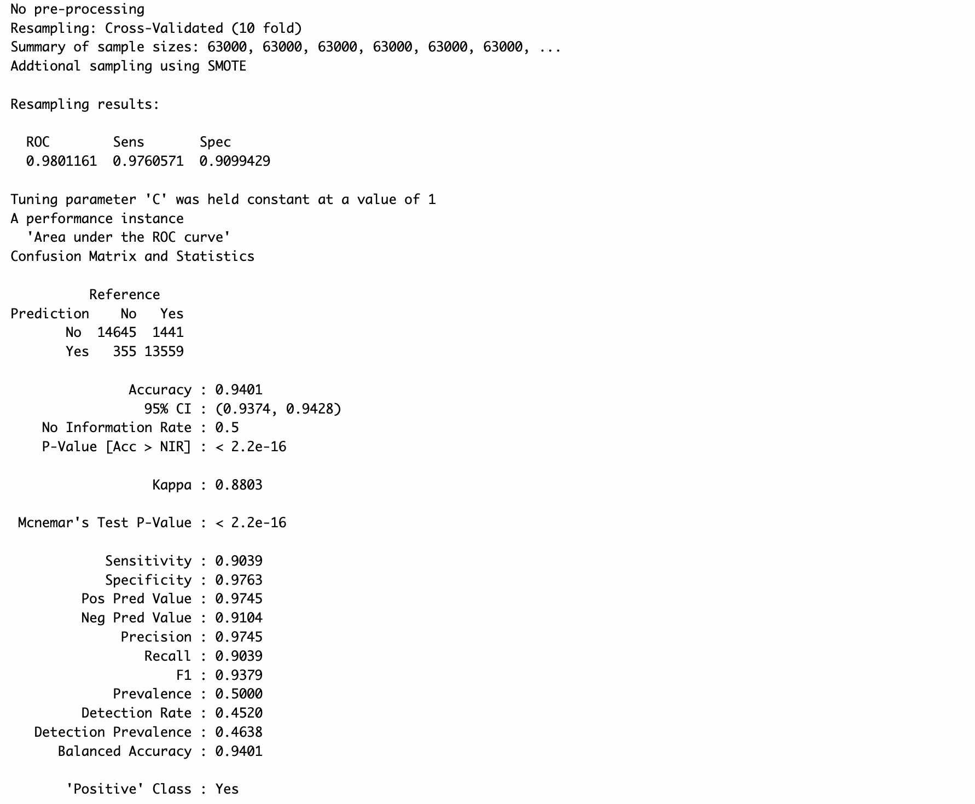
Training the Models SVM Linear and SVM Linear with Smote
SVM Linear and with Smote Models returned accuracy of 94.21

Slide 25
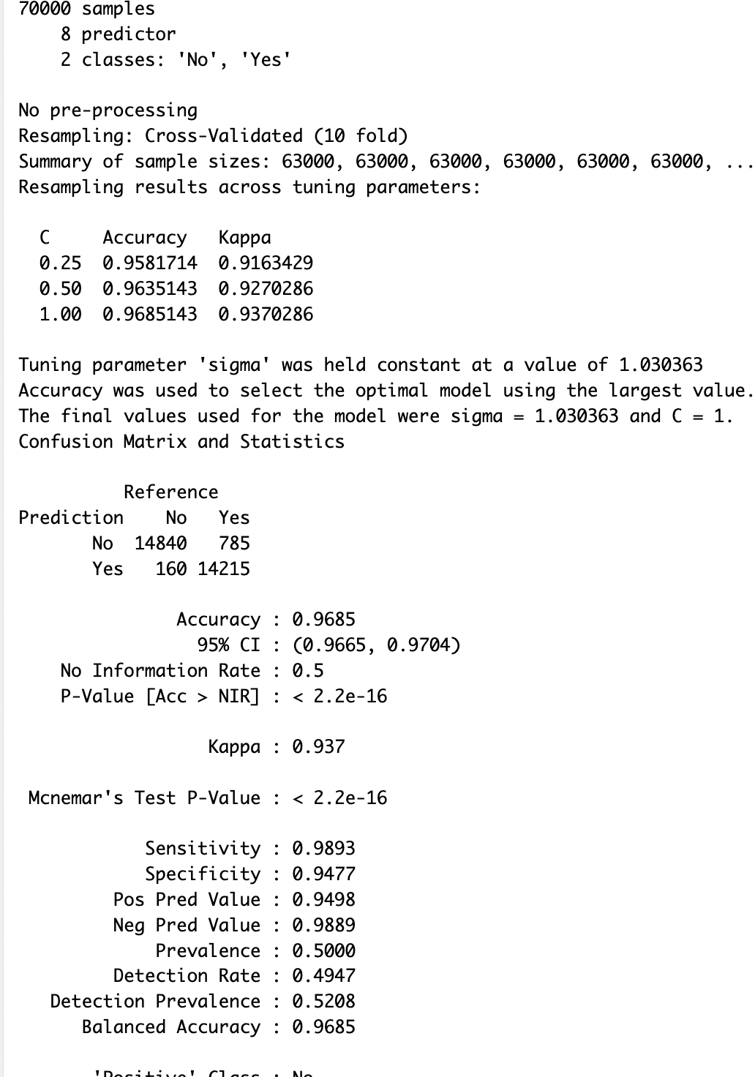
Training the Models SVM Radical
SVM Radical returned accuracy of 96.85

Slide 26
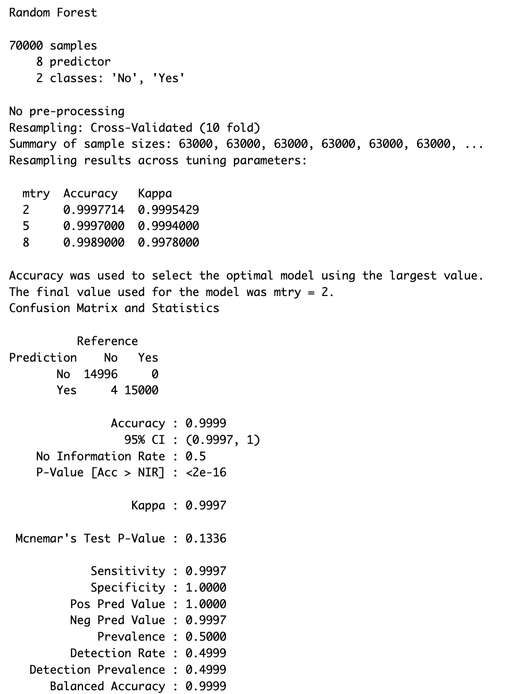
Training the Models Random Forest
Random Forest returned accuracy of 96.85

Slide 27
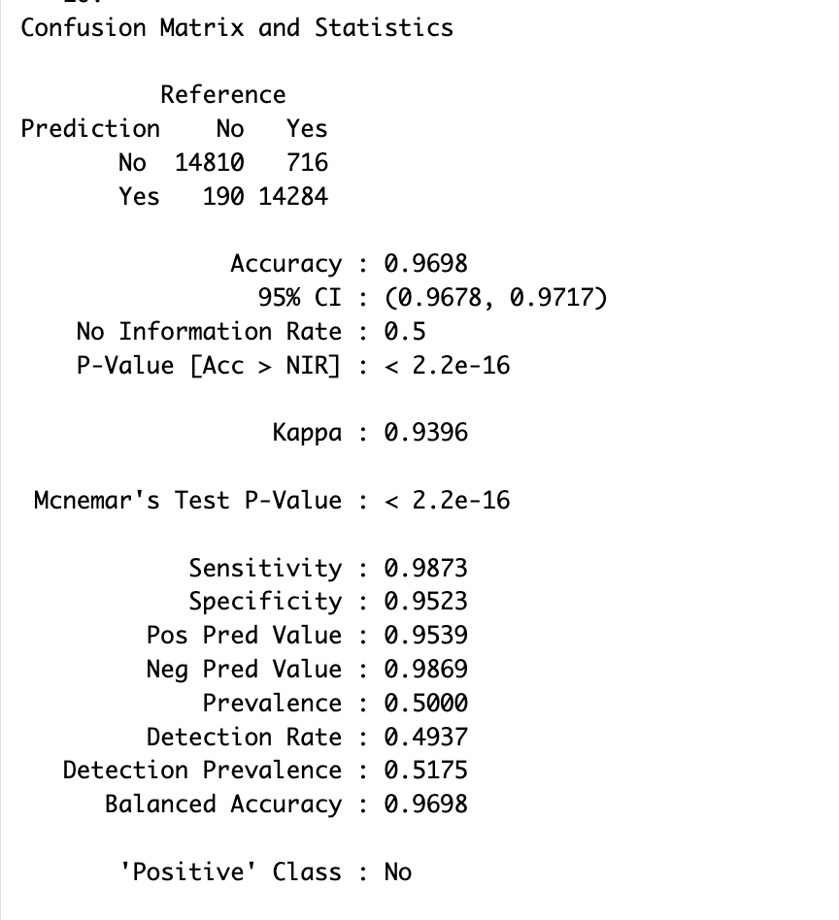
Training the Models Gradient Boosted model
GB Tree Model returned accuracy of 96.98

Slide 28
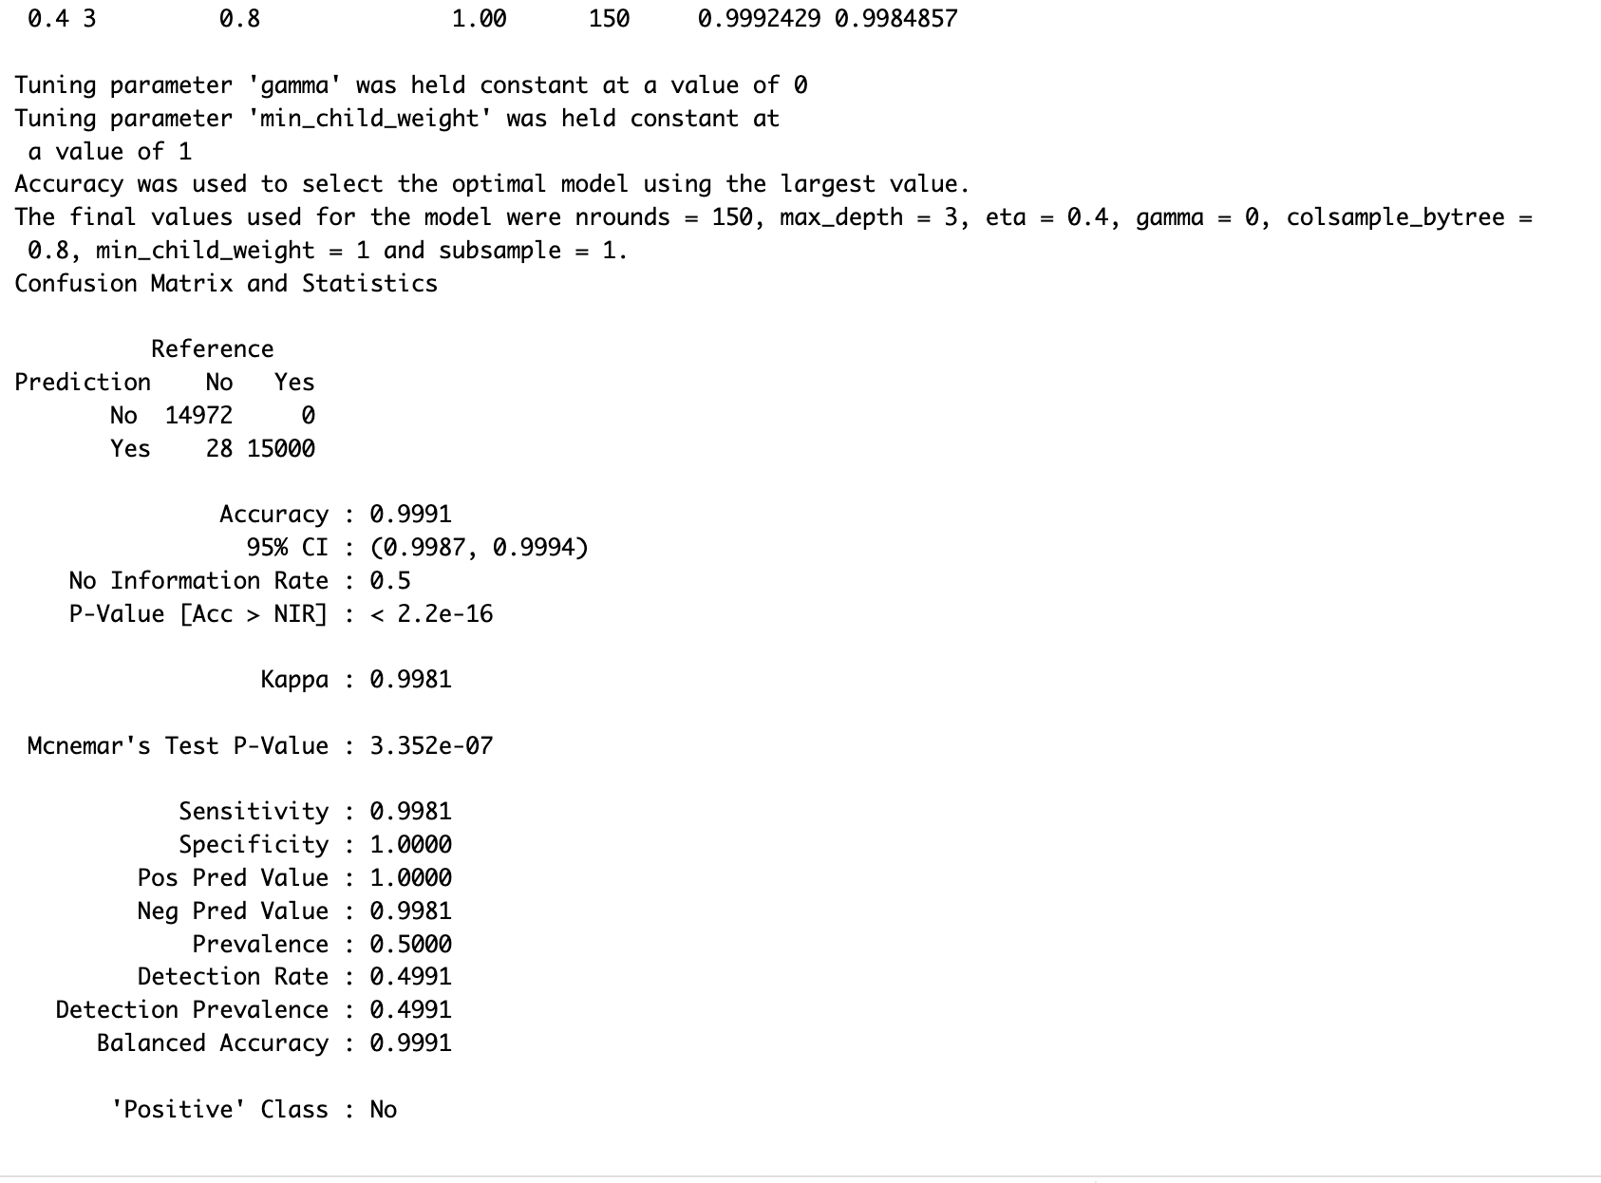
Training the Models eXtreme Gradient Boosted model
XGB Tree Model returned accuracy of 99.91

Slide 29
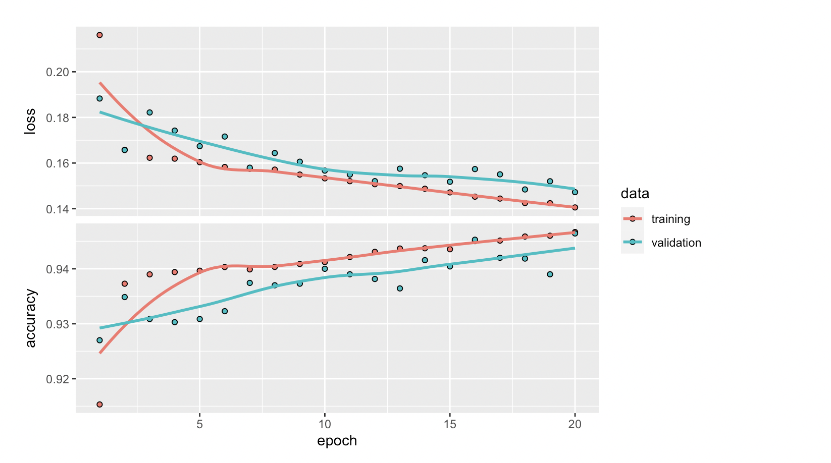
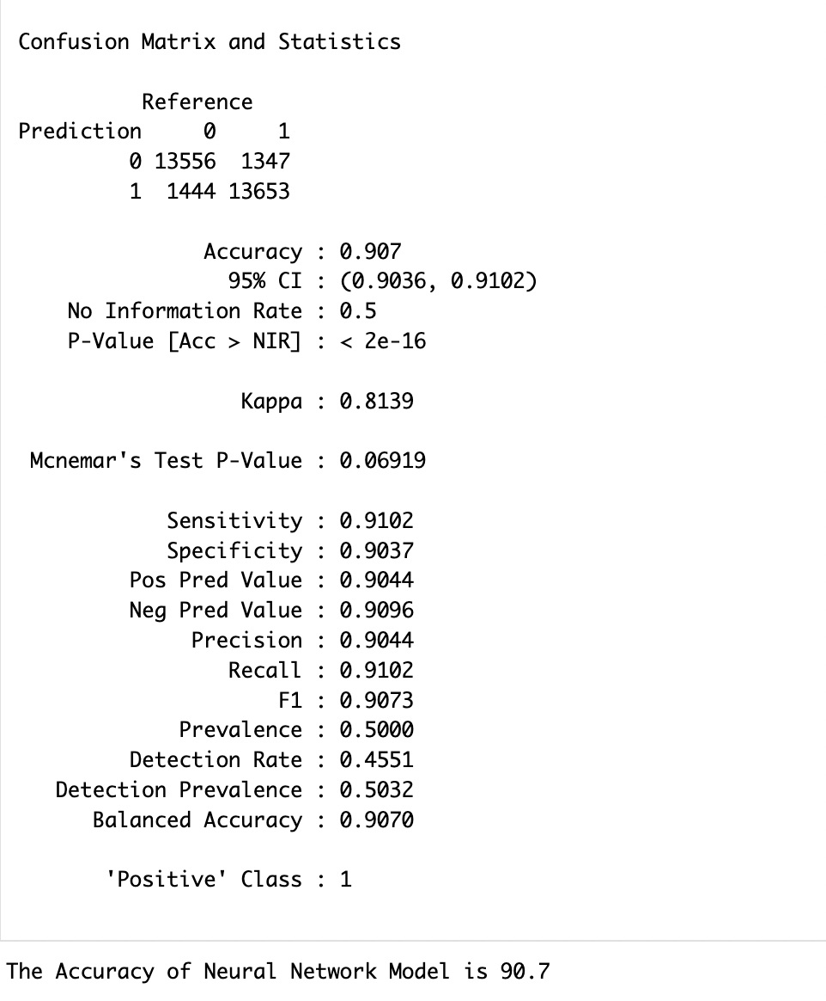
Training the Models Neural Network Model
Neural Network Model returned accuracy of 90.7

Slide 30
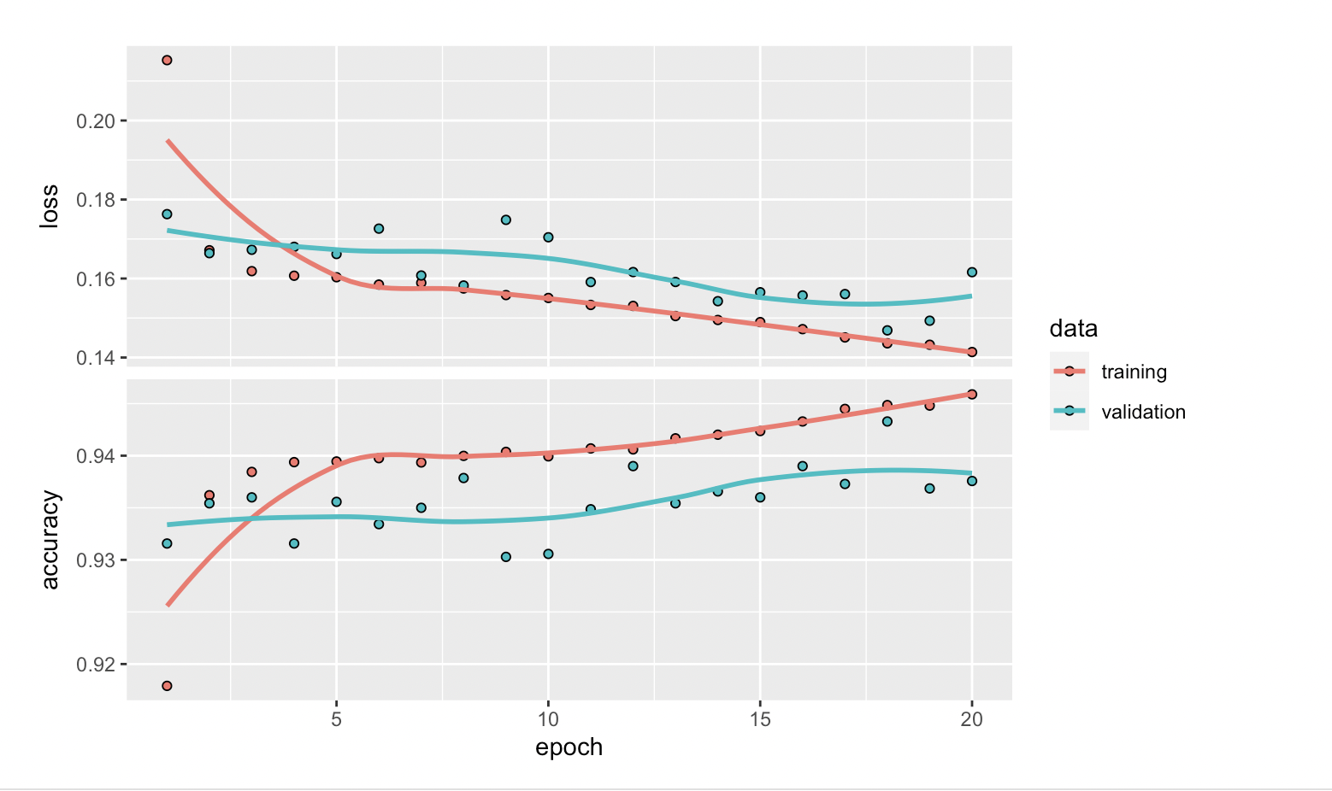
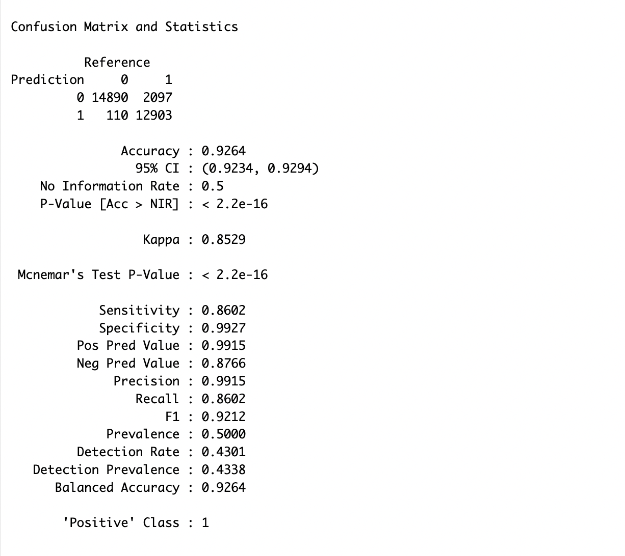
Training the Models Neural Network Model with Class weight
Neural Network Model returned accuracy of 92.64

Slide 31
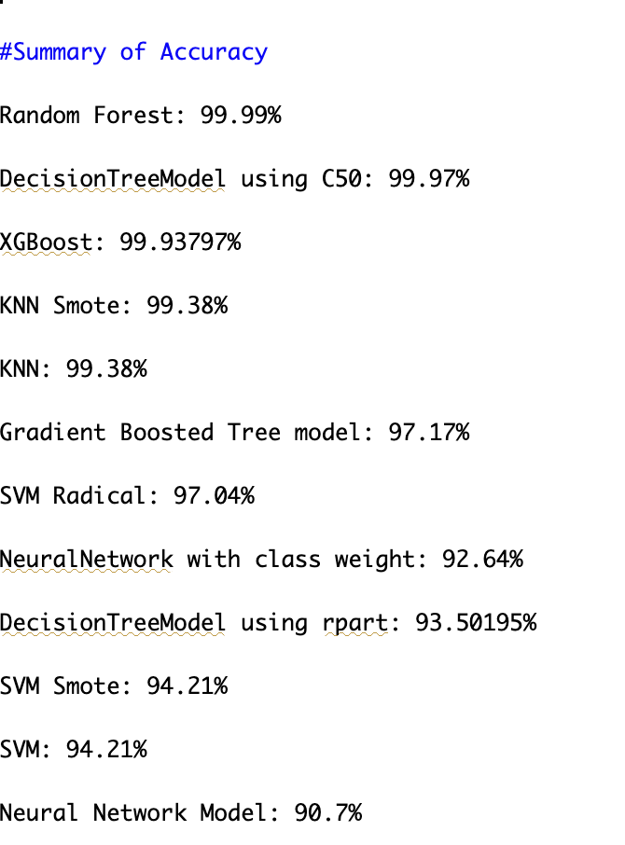
Results
Random Forest performed the best with 99.99% accuracy.

